Slide 1
Unified mentor- machine learning internship project
American sign language detection using neural networks
Presentation by
Indumathi Rajendran

Slide 2
agenda
Introduction
Objective
Dataset Overview
Exploratory Data Analysis (EDA)
Data Preprocessing
Model Building
Model Evaluation
Model Deployment
Conclusion

Slide 3
introduction
American Sign Language (ASL) is a crucial tool for communication among the deaf and hard-of-hearing community. This project focuses on building a deep learning model that can recognize ASL hand signs from images and predict the corresponding alphabet.
ASL recognition helps bridge the communication gap between sign language users and those unfamiliar with it, promoting inclusivity.
The integration of computer vision and neural networks allows real-time interpretation of signs, paving the way for assistive technologies and educational tools.

Slide 4
Objective
The objective of this project is to develop an automated system that can accurately identify and classify hand signs from American Sign Language (ASL) images. The system should be capable of recognizing 29 distinct classes, including the 26 English alphabets and 3 special signs: SPACE, DELETE, and NOTHING. The aim is to leverage deep learning techniques, particularly Convolutional Neural Networks (CNNs), to extract visual features from hand gestures and map them to their corresponding labels.

Slide 5
Dataset overview
The dataset used for this project is the ASL Alphabet Dataset from Kaggle, containing images of 29 classes: 26 for the English alphabets (A–Z) and 3 for SPACE, DELETE, and NOTHING. It includes separate training and testing sets, with each class stored in its own folder. The images are consistent in size and format, making them suitable for training deep learning models for multi-class classification tasks.

Slide 6
Exploratory data analysis
Exploratory Data Analysis was performed to understand the distribution and characteristics of the ASL image dataset. The number of images per class was analyzed to check for class imbalance, and it was observed that the dataset is relatively well-balanced across all 29 categories. Sample images from each class were visualized to ensure proper labeling and clarity of hand gestures. Image dimensions and color channels were also examined to standardize input size and format for model training. This initial analysis provided valuable insights into the dataset's structure and guided the preprocessing and augmentation strategies.

Slide 7
Data preprocessing
Data preprocessing involved preparing the ASL images for effective model training. All images were resized to a fixed dimension (e.g., 64x64 pixels) to maintain consistency and reduce computational load. Pixel values were normalized to a range between 0 and 1 to improve training stability. Labels were one-hot encoded to support multi-class classification. Additionally, data augmentation techniques such as rotation, zoom, flipping, and shifting were applied to artificially expand the dataset and improve the model’s ability to generalize across varied hand positions and lighting conditions.

Slide 8
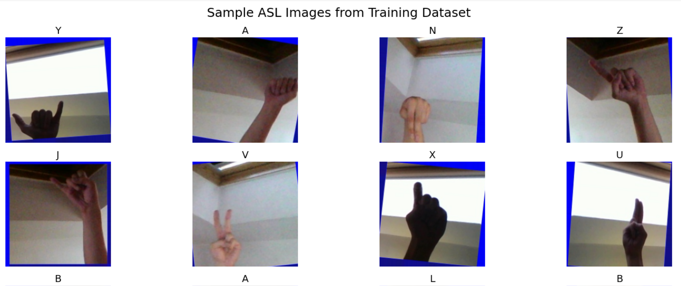
ASL Images

Slide 9
Model building
A Convolutional Neural Network (CNN) was designed and trained to classify the ASL hand sign images into 29 distinct categories. CNNs are highly effective in image classification tasks due to their ability to automatically learn spatial hierarchies of features. The model was built using sequential layers, combining convolutional and pooling layers to extract features, followed by dense layers for classification. Dropout layers were also included to reduce overfitting and enhance generalization.
Key components of the model:
Input Layer: Accepts resized RGB images (e.g., 64x64x3).
Convolutional Layers: Extract spatial features using filters.
MaxPooling Layers: Downsample feature maps to reduce dimensionality.
Dropout Layers: Prevent overfitting by randomly disabling neurons during training.
Flatten Layer: Converts 2D feature maps into 1D vectors.
Dense Layers: Fully connected layers for learning high-level representations.
Output Layer: Softmax activation to classify input into 29 ASL categories.
Optimizer: Adam optimizer for efficient gradient updates.
Loss Function: Categorical crossentropy used for multi-class classification.

Slide 10
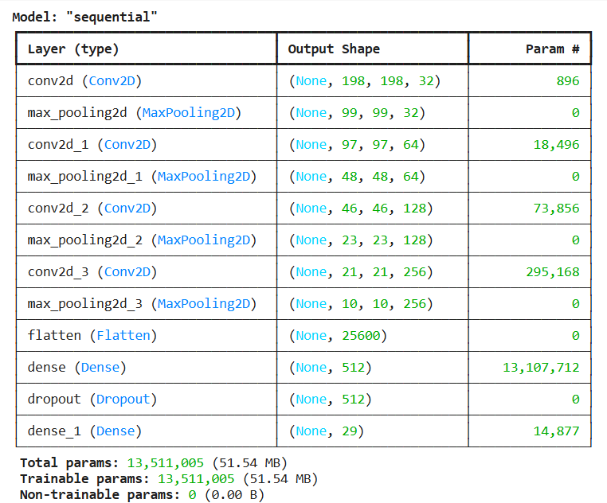
Cnn model summary

Slide 11
Model evaluation
The trained CNN model was evaluated using various metrics to assess its performance on the test data. Accuracy was used as the primary evaluation metric, supported by loss values to monitor learning progress. The model achieved high accuracy, indicating effective learning and generalization. A confusion matrix was generated to visualize classification performance across all 29 classes, helping identify any misclassified signs.
Evaluation highlights:
Accuracy: High classification accuracy on the test set.
Loss: Low final training and validation loss.
Confusion Matrix: Used to detect class-wise prediction performance.
Precision, Recall, F1-Score: Assessed for overall model robustness.
Training vs. Validation Curves: Checked for signs of overfitting or underfitting.

Slide 12
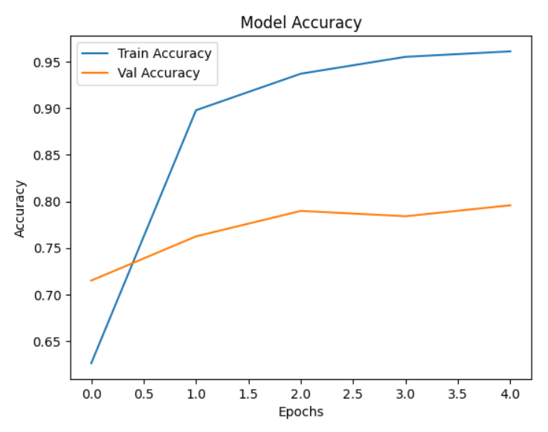
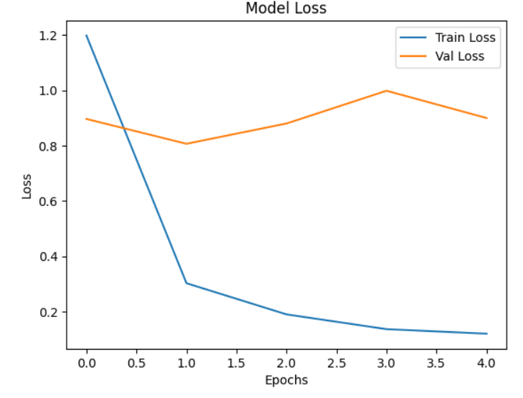
Model performance

Slide 13
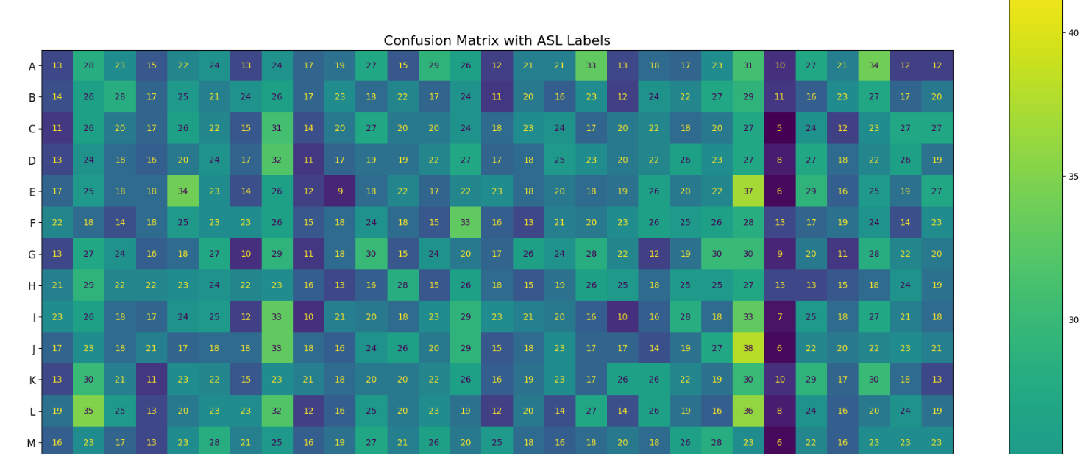
Model evaluation – confusion matrix

Slide 14
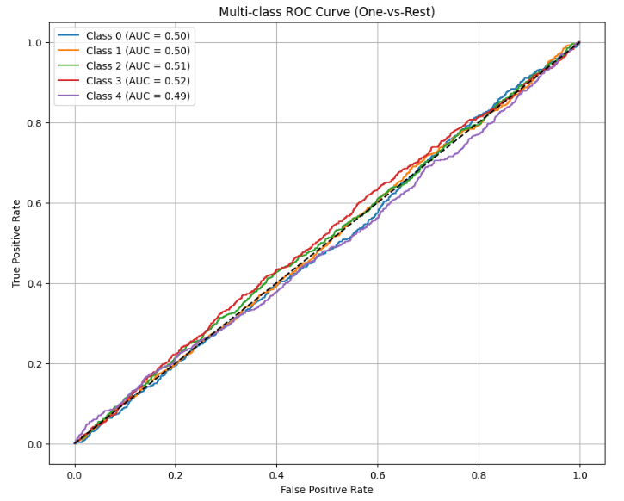
Model evaluation – multi-class roc curve

Slide 15
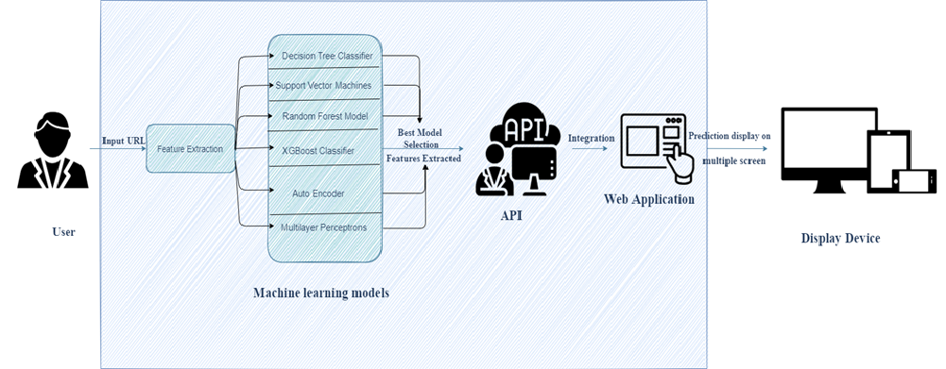
Architectural design and deployment
The trained model was integrated into a Flask web framework for deployment. The model was serialized using joblib and loaded into a Flask API endpoint. A simple HTML/CSS frontend was created to accept user inputs, which are sent to the backend via HTTP POST requests.

Slide 16
Model deployment
The trained ASL recognition model was deployed using a Flask API backend, integrated with a simple HTML/CSS frontend to create a user-friendly web interface. This setup allows users to upload images of ASL hand signs, which are then processed and predicted by the model in real-time. The Flask server loads the saved model, handles image preprocessing, and returns the predicted class to be displayed on the frontend. This deployment approach enables easy accessibility and paves the way for future enhancements like mobile or cloud-based integration.
Deployment components:
Backend: Flask API to serve the trained model.
Frontend: HTML/CSS interface for image upload and result display.
Model Loading: Pretrained model loaded using TensorFlow/Keras.
Image Handling: Uploaded image resized and preprocessed before prediction.
Prediction Output: Displayed on the web page after model inference.

Slide 17
Web application design
1. Web Application Development
Designed a user-friendly, browser-compatible web UI
Enabled input & prediction display
Built using HTML, CSS, JavaScript (or React)
2. Model Integration
Integrated final model into the backend (Flask/Django)
Connected model predictions to the frontend
Ensured real-time detection functionality
3. Deployment & Testing
Deployed web app to a live server
Tested for performance & user feedback
Ensured system stability and speed

Slide 18

Asl detection web app

Slide 19
conclusion
The American Sign Language Detection project successfully demonstrates the use of deep learning for recognizing hand signs from static images. By leveraging a Convolutional Neural Network, the model achieved high accuracy in classifying 29 ASL categories, including alphabets and special gestures. The combination of proper data preprocessing, augmentation, and model tuning contributed to its strong performance. The deployment using Flask and a web interface makes the solution accessible and interactive, offering real-world applicability in assistive communication tools. This project lays a solid foundation for future improvements such as dynamic gesture recognition and real-time video-based interpretation.

Slide 20
Thank you

